Slide 1
Linear algebra:
Eigenvalues and eigenvector
主讲人：常万里

Slide 2

Reference
MIT 18.06 Linear Algebra
https://ocw.mit.edu/courses/mathematics/18-06-linear-algebra-spring-2010/
http://open.163.com/special/opencourse/daishu.html

Slide 3
Index
Eigenvectors and eigenvalues
Geometric meaning
Examples

Slide 4
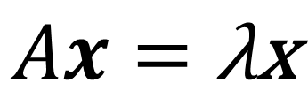
Eigenvectors and eigenvalues
A matrix A acts on vectors x like a function does, with input x and output Ax. Eigenvectors are vectors for which Ax is parallel to x. In other words:
$$Ax=\text{λ}\text{x}$$
In this equation, x is an eigenvector of A and λ is an eigenvalue of A.

Slide 5
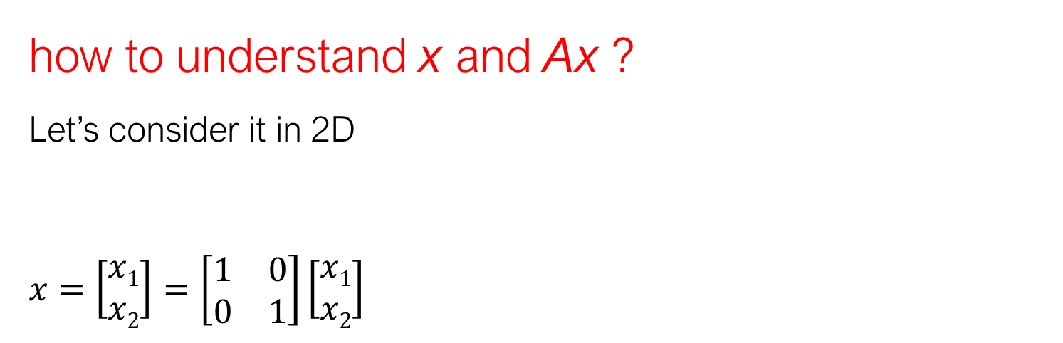
Geometric meaning
how to understand x and Ax ?
Let’s consider it in 2D
$$x=\left[\begin{aligned}x1 \\ x2\end{aligned}\right]=\left[\begin{matrix}1 & 0 \\ 0 & 1\end{matrix}\right]\left[\begin{aligned}x1 \\ x2\end{aligned}\right]$$
Notes:
By “closest” line we mean one that minimizes the error represented by the distance from the points to the line.
We measure that error by adding up the squares of these distances. In other words, we want to minimize ||Ax ⁻ b|| ² =||e||²

Slide 6
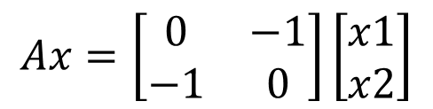
$$Ax=\left[\begin{matrix}0 & −1 \\ −1 & 0\end{matrix}\right]\left[\begin{aligned}x1 \\ x2\end{aligned}\right]$$

Slide 7
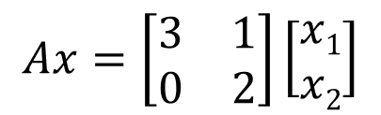
$$Ax=\left[\begin{matrix}3 & 1 \\ 0 & 2\end{matrix}\right]\left[\begin{aligned}x1 \\ x2\end{aligned}\right]$$

Slide 8
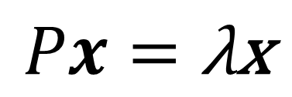
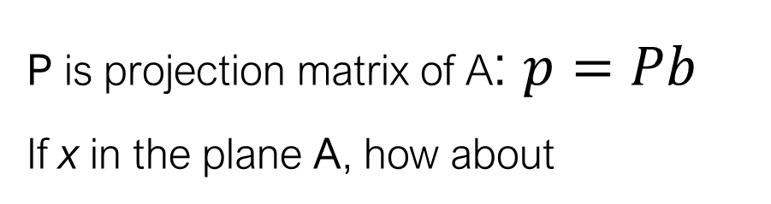
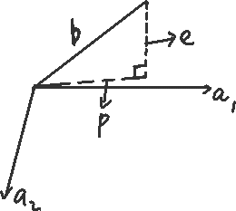
Examples
$\text{P} \text{is} \text{projection} \text{matrix} \text{of} \text{A}$: $p=Pb$
If x in the plane A, how about
$$Px=\text{λ}\text{x}$$

Slide 9
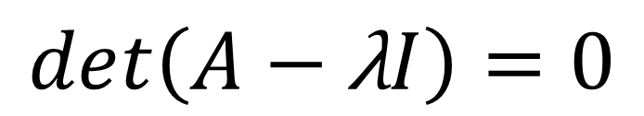
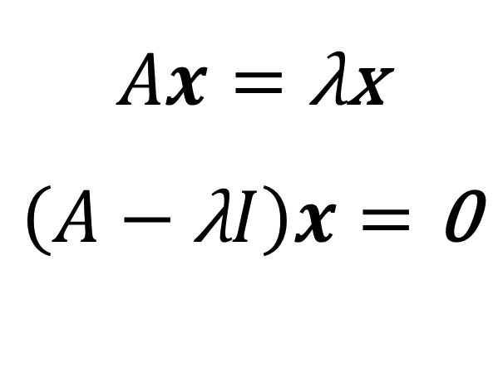
For normal case :
$$Ax=\text{λ}\text{x}$$
$$\left(A−\text{λ}I\right)x=\text{0}$$
Singular !
$$det\left(A−\text{λ}I\right)=0$$

Slide 10
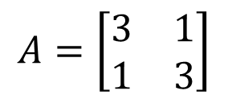
Calculating eigenvalues and eigenvectors
$$A=\left[\begin{matrix}3 & 1 \\ 1 & 3\end{matrix}\right]$$

Slide 11
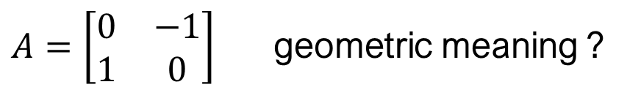
$A=\left[\begin{matrix}0 & −1 \\ 1 & 0\end{matrix}\right]$ geometric meaning ?

